Slide 1

GROUP PRESENTATION
“Topic: Prediction of Heart Disease Using Machine Learning”
CSE 299 Section : 1
North South University | 2025

Slide 2
Presented by Group 5
Al Imran 212071642
MD. Mukzanul Alam Nishat 2212445042
Khondker Sayif Ali 2111323642
Arman Hossain Nawmee 2221395042
MD Araf UI Haque Dhrubo 2021493042

Slide 3
Why we chose heart disease?
"We chose heart disease because it is a global health crisis. According to the World Health Organization (WHO), heart disease causes 17.9 million deaths per year, making it the leading cause of death worldwide.
The biggest challenge is early detection. Many people don’t realize they have heart disease until it’s too late. By the time they experience symptoms, serious damage may have already occurred.
Traditional methods of diagnosis, such as ECGs and blood tests, require expert analysis and take time. But ML can process vast amounts of patient data in seconds and provide fast, accurate predictions.
Let’s take an example: Suppose a hospital receives 100 patients a day showing heart disease symptoms. Doctors have to manually examine each case. With ML, we can analyze all cases within minutes, providing early warning signs and helping doctors prioritize critical patients.
This is why we chose heart disease – to help speed up diagnosis, reduce misdiagnosis, and ultimately save lives."

Slide 4
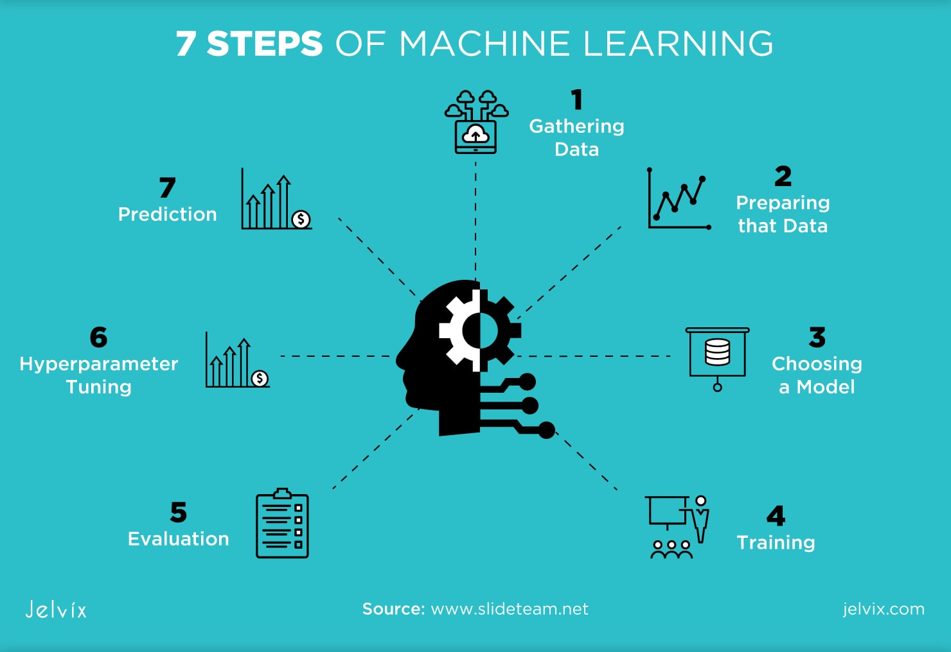

Slide 5
"Our project focuses on using machine learning to predict heart disease. Machine learning is a type of artificial intelligence (AI) that allows computers to learn from data and make predictions”. We will be using four different ML models:
Decision Trees – A simple model that makes decisions like a flowchart.
Random Forest – A combination of many decision trees, making predictions more accurate.
Support Vector Machines (SVM) – A model that classifies patients into two categories: healthy or at risk.
Regression-based approaches – Used to find relationships between health indicators and heart disease risk.

Slide 6
What is our aim?
"The main goal of our project is to train and test ML models for heart disease detection.
We aim to:
Find the best-performing model for heart disease prediction.
Analyze patient data and identify key factors that contribute to heart disease.
Improve healthcare efficiency by providing doctors with a tool that can assist in early diagnosis.
To do this, we will evaluate models based on:
Accuracy
Precision & Recall
F1-score

Slide 7
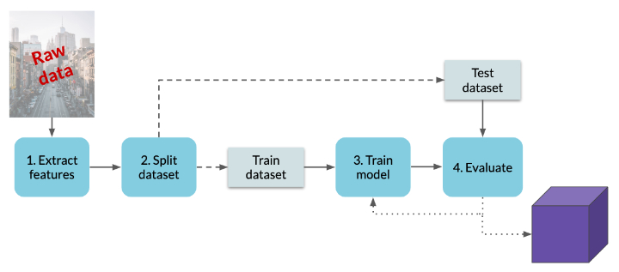
Workflow

Slide 8
Age
Which dataset are we going to use?
"We are using a heart disease dataset from Kaggle, a well-known data science platform.
This dataset contains patient health records with important information like:
Blood Pressure
Cholesterol Levels
Heart Rate, Diabetes, and ECG Results

Slide 9
Tabular heart disease dataset available on Kaggle
"Our dataset is structured in a tabular format, meaning it is organized in rows and columns. Each row represents a patient, and each column represents a health feature.
This structured data allows us to train ML models effectively. Some of the key features in our dataset include:
Age, Gender, and Family History
Symptoms like Chest Pain Type, Blood Pressure, Cholesterol
Test results like ECG and Maximum Heart Rate Achieved
Using these features, our models will learn how to distinguish between healthy and at-risk patients.
Once trained, the ML model will be able to predict whether a new patient has heart disease based on their health indicators."

Slide 10
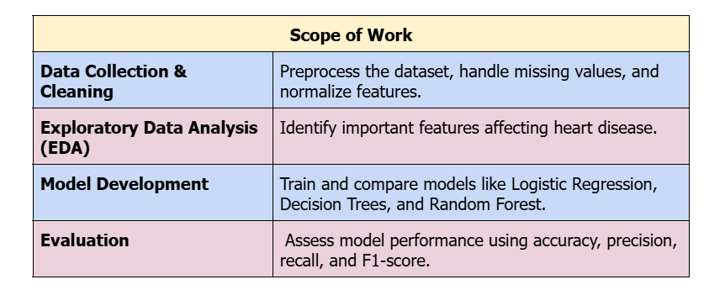

Slide 11
Handling missing and imbalanced data.
Choosing the best features for accurate predictions.
Challenges
Selecting the most effective machine learning model.
Ensuring model interpretability for real-world application.

Slide 12
Conclusion
"In conclusion, our project aims to use machine learning to predict heart disease more accurately and efficiently.
By comparing different ML models, we hope to find the best approach for heart disease prediction. This research can help doctors detect heart disease earlier, saving lives and improving healthcare.
In the future, this technology could be used in hospitals worldwide, helping millions of patients with faster and more accurate diagnoses.

Slide 13
THANK YOU

